Slide 2
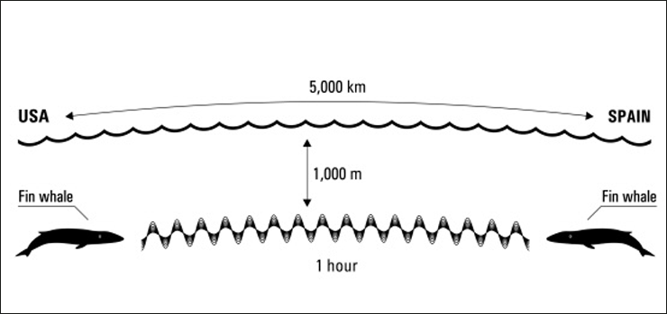
Sound and light in the Sea

Slide 3
Sound Transmission
Sound is transferred by the vibration of adjacent molecules
Sound waves are produced by pressure changes between molecules
Sound is affected by water much less than light and thus has good penetration properties in water
This allows it to be used for study and communication purposes
The speed of sound is 4 times greater in water than air
The speed of sound increases with increasing temperature and pressure – due to the change in speed (Temperature) or compacting of the water molecules (Pressure) (see lecture on Temperature)

Slide 4
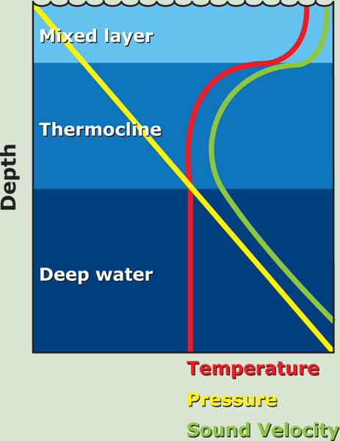
Above the thermocline increasing pressure
with depth increases the speed of sound
despite the gradual decrease in temperature.

Slide 5
Within the pycnocline, the speed of sound decreases rapidly because of the rapid decrease in temperature
and only slight increase in pressure.

Slide 6
Below the thermocline the speed of sound gradually increases because pressure
continues to increase, but temperature only
declines slightly.

Slide 7
T | S | P | Speed of Sound ms⁻¹
20 | 33 | 100 | 1521
 | 35 |  | 1523
 | 36 |  | 1524
10 | 33 | 100 | 1489
 | 35 | 100 | 1491
 | 36 | 100 | 1493
20 | 33 | 1000 | 1537
 | 35 | 1000 | 1538
 | 36 | 1000 | 1539

Slide 8
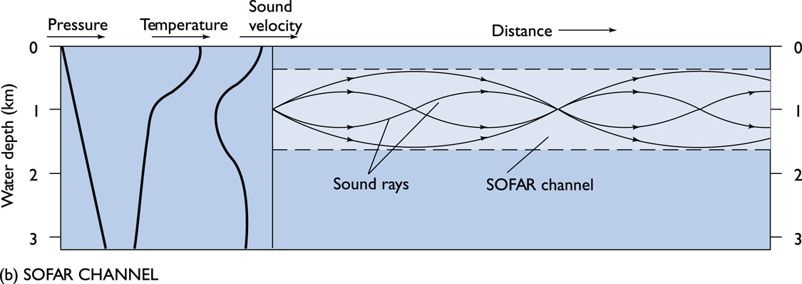
Sound travels along a straight path where the sound speed c is constant; it bends toward the region of lower c otherwise

Slide 9
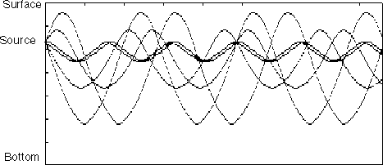

Slide 10
Why do sound waves bend in the SOFAR channel?
Sound is focused in the sound channel because the sound waves are continually bent, or refracted, towards the region of lower sound speed. Above the SOFAR channel, the rapidly falling temperature (at the thermocline) causes a decrease in sound speed.
Below the SOFAR channel, the increasing pressure causes an increase in sound speed.
Sound waves can become "trapped" in the deep sound channel and propagate long distances because they experience little attenuation.

Slide 11
Sound Transmission
Acoustic Thermography: This is a technique to precisely determine travel times in water over large distances by noting how the speed of sound changes with temperature
Involves a low frequency sound produced in the sound channel. This sound travels around the world, with the time taken for it to arrive at different stations measured precisely
Since the speed of sound increasing with temperature, if the oceans are warming, the signal will take less time to arrive at its destination.

Slide 12
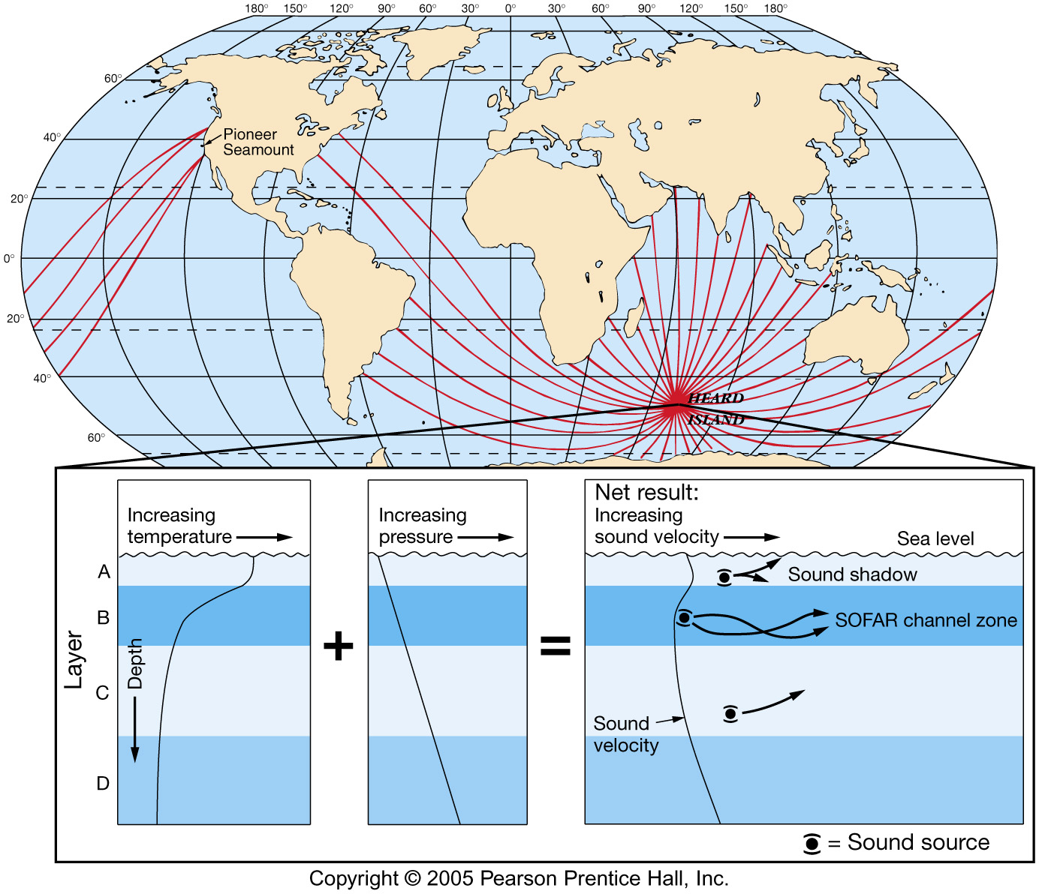
Heard Island Experiment

Slide 13
The speed of sound depends on the medium through which sound waves propagate - The influence of salinity on sound is negligable – although there are changes in the density range = 23 – 29 sigma-t
The propagation of sound waves in sea water can be directly affected by suspensions of particulate matter that can scatter, absorb, or reflect the waves.
Sound travels faster as temperature increases due to the increase in energy of the molecules.
Sound increases as pressure increases due to increase in the compression of the sound waves.

Slide 14
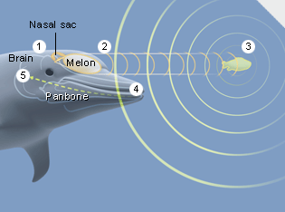
Echolocation
Marine mammals use sound rather than light to “see” in the ocean
Echolocation –use of reflected sound to detect environmental objects
They use echolocation to detect prey and avoid obstacles

Slide 15
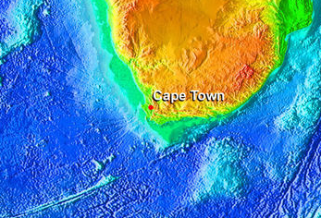
Using sound to map the ocean floor
Bathymetry – measurement of ocean depths and the charting of the shape or topography of the ocean floor
Echo sounder (also referred to as sonar)
Invented in the 1920s
Primary instrument for measuring depth
Reflects sound from ocean floor

Slide 16
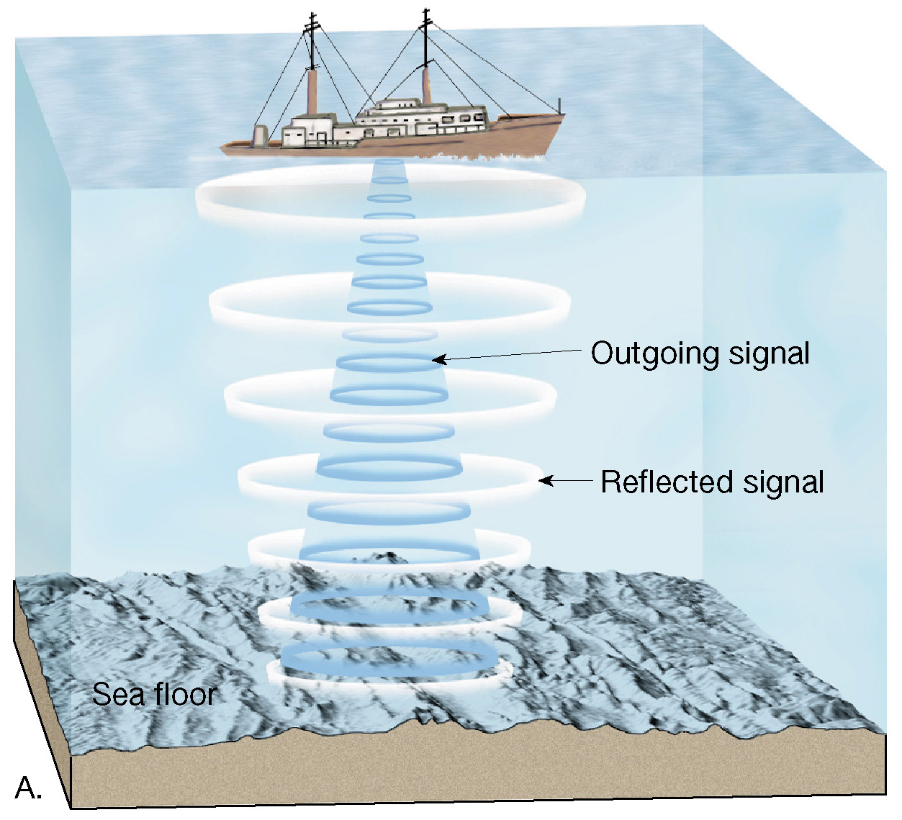

Slide 17
Multibeam sonar
Employs and array of sound sources and listening devices
Obtains a profile of a narrow strip of seafloor
Measuring the shape of the ocean surface from space

Slide 18
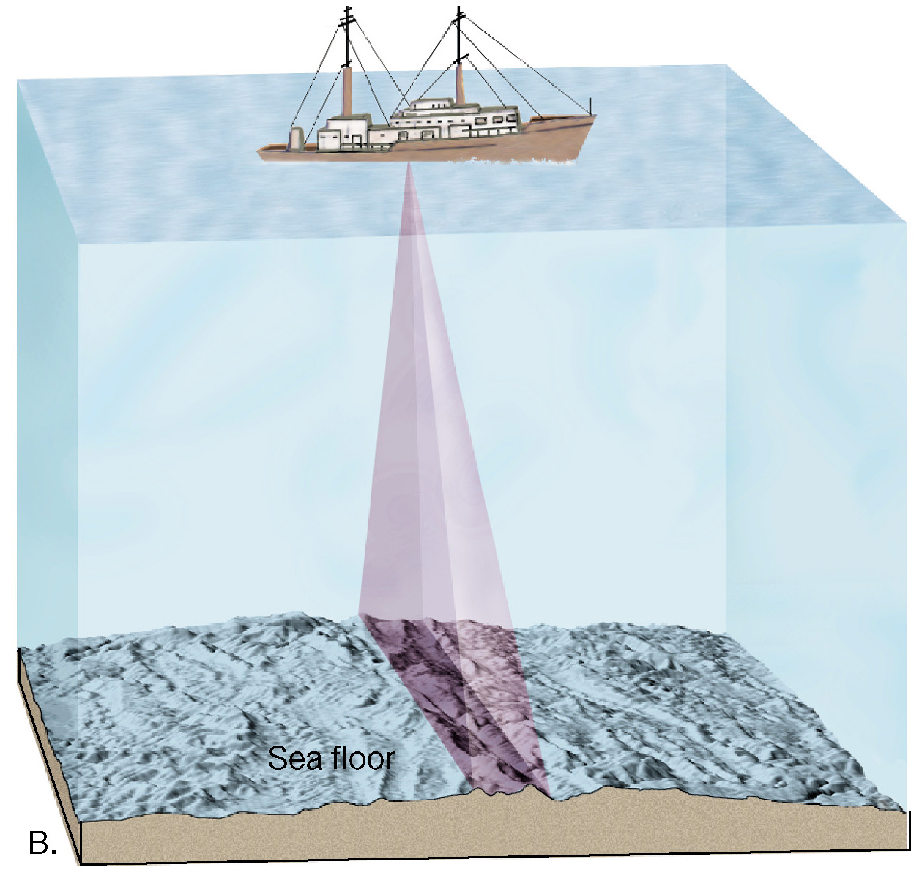
Multibeam sonar

Slide 19
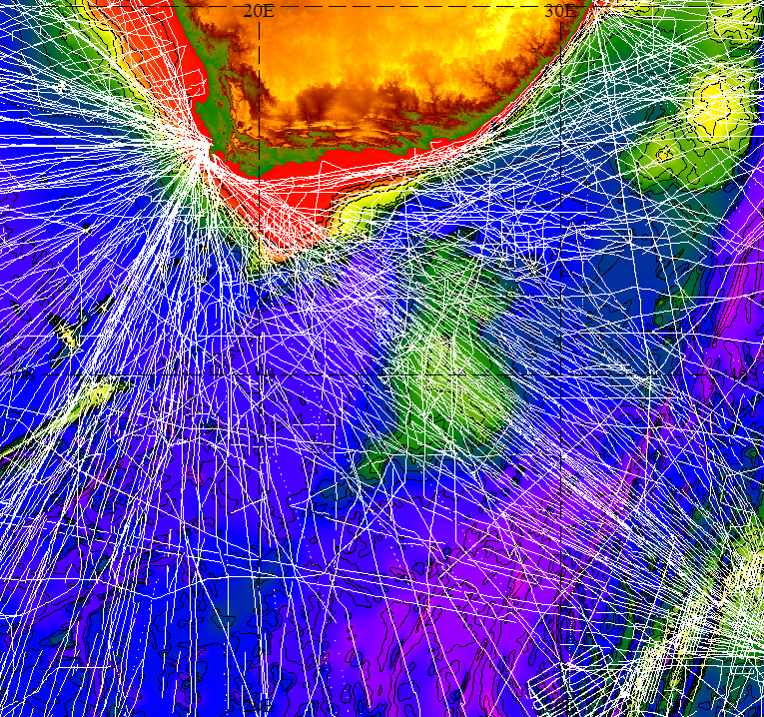
Sea floor with track lines..

Slide 20
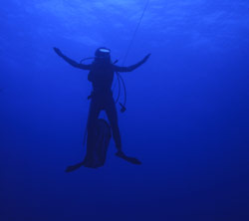

Slide 21
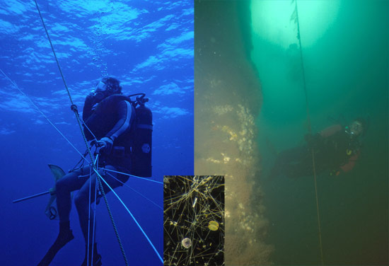
DIVING INTO DIFFERENT WORLDS: Open ocean water (left) coastal (right)

Slide 22
Water color and life in the ocean
Ocean color is influenced by:
The amount of turbidity from runoff
The amount of photosynthetic pigment, which corresponds to the amount of productivity
Yellow-green = highly productive water
Found in coastal and upwelling areas (eutrophic)
Clear indigo blue = low productivity water
Found in the tropics and open ocean (oligotrophic)

Slide 23
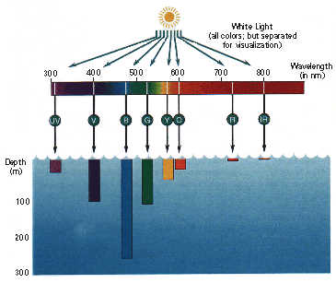
Light in the sea comes from two sources: sun and organisms

Slide 24
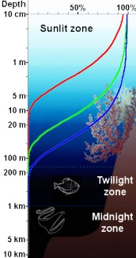
Light Zones
Sunlit zone
PHOTIC/SUNLIGHT ZONE – 200m
Plants thrive; food relatively abundant
DYSPHOTIC/TWILIGHT ZONE – 1000m
Dim light can’t support plants, reduced food; 20% of photic zone production; T= 23 > 4˚C (thermocline region)
APHOTIC/MIDNIGHT ZONE – below 1000m
Perpetual darkness; only 5% of photic zone food production; T= 4˚C
Twilight Zone
Midnight Zone

Slide 25
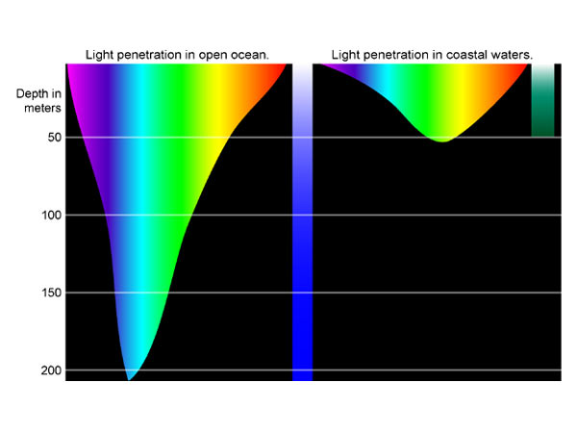
Light Absorption in the Ocean
Light Intensity -decreases with depth
0-100 m (photic zone)
100-1000m (dysphotic zone)
>1000 (aphotic zone)

Slide 26
The amount of light entering the ocean depends upon the height of the sun above the horizon and the smoothness of sea surface.
65% of light entering the ocean is absorbed within the first meter and converted into heat. Only 1% of light entering the ocean reaches 100m.
Water displays the selective absorption of light with long wavelengths absorbed first and short wavelengths absorbed last.
In the open ocean, blue light penetrates the deepest.

Slide 27
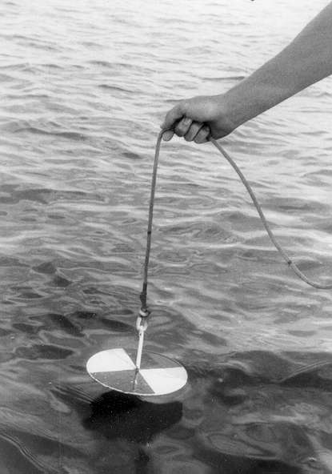
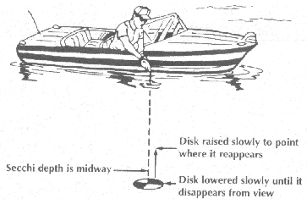
The depth of light penetration measured by a white "Secchi" disc lowered from the ship.

Slide 28
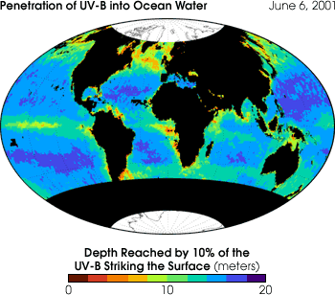

Slide 29
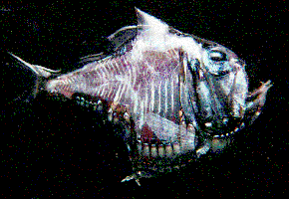
Light effects organisms residing in the photic and aphotic zone.
Phytoplankton productivity
Algae- green, brown, red
Predator/Prey relationships
Diurnal vertical migration
Bioluminescence- luminescent organs on underside mimic downwelling light

Slide 30
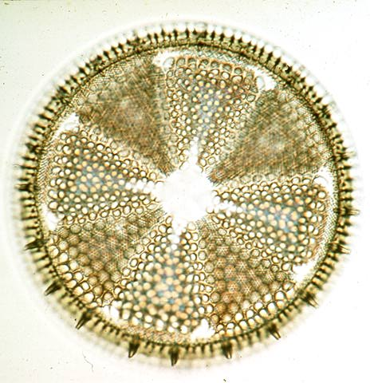
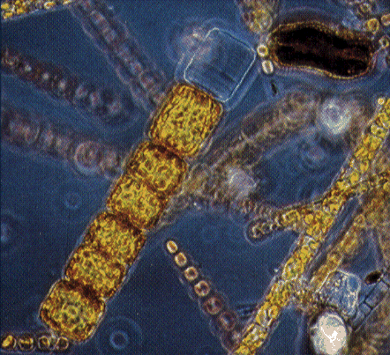
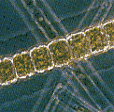
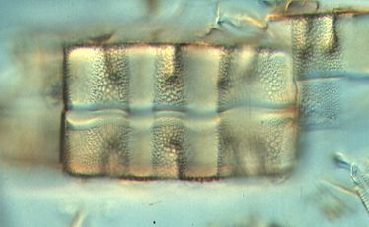

Slide 31
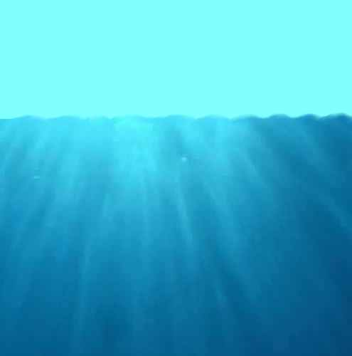
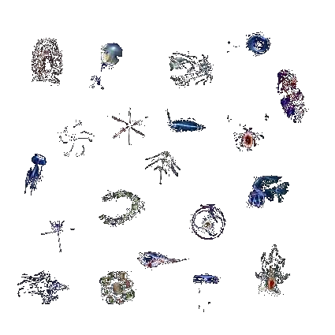
downwelling
irradiance E_{d}
water-leaving
radiance L_{w}
backscattering b_{b}
absorption a
fluorescence
scattering b

Slide 32
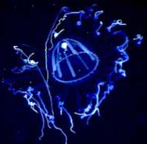
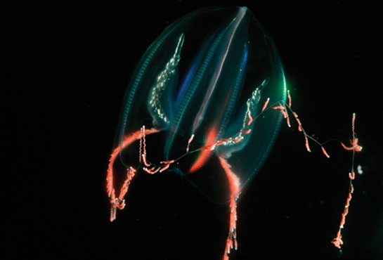
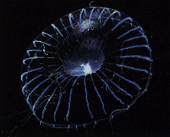
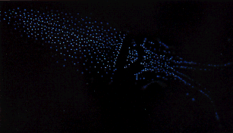
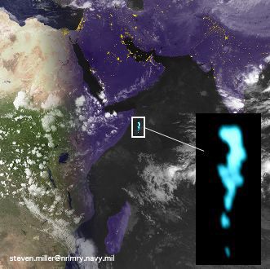

Slide 33
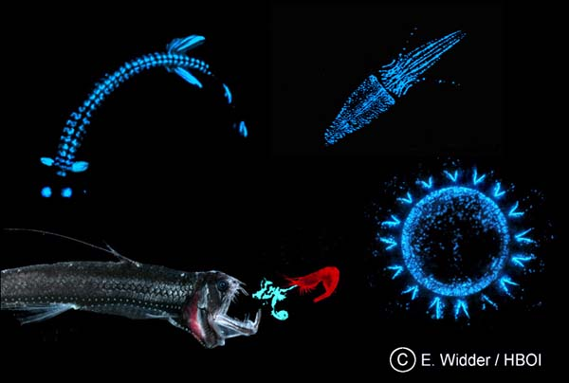

Slide 34
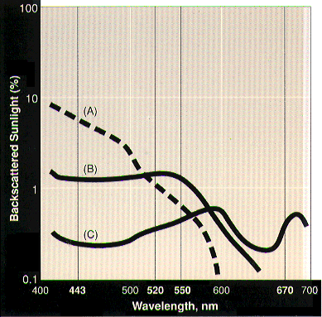
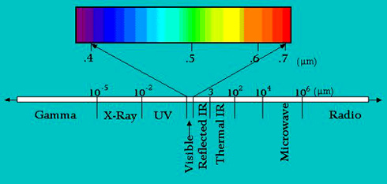
Thus, ocean color can be measured on the basis of the spectrum of visible light emitted from the study object.
Clean ocean water (A) has maximum in short (blue) wavelength and almost zero in yellow and red. HENCE WHY DEEP OCEANS LOOK BLUE

Slide 35
B is higher in phytoplankton (i.e., chlorophyll and other plant pigments) concentration hence green color (B).

Slide 36
In coastal zones with high concentration of dead organic and inorganic matter light spectrum has maximum in red (C). Hence Brown

